Slide 1

Uber – mini project
Harish Rewatkar
© All rights reserved by Fireblaze Technologies Pvt. Ltd.

Slide 2
Problem Statement
- Maximum amount of restaurants are listed on zomato in the world but not indian people are aware about we can get food online with home delivery.
© All rights reserved by Fireblaze Technologies Pvt. Ltd.

Slide 3
Proposed Solution
Create more awareness about the brand for young generation.
© All rights reserved by Fireblaze Technologies Pvt. Ltd.

Slide 4
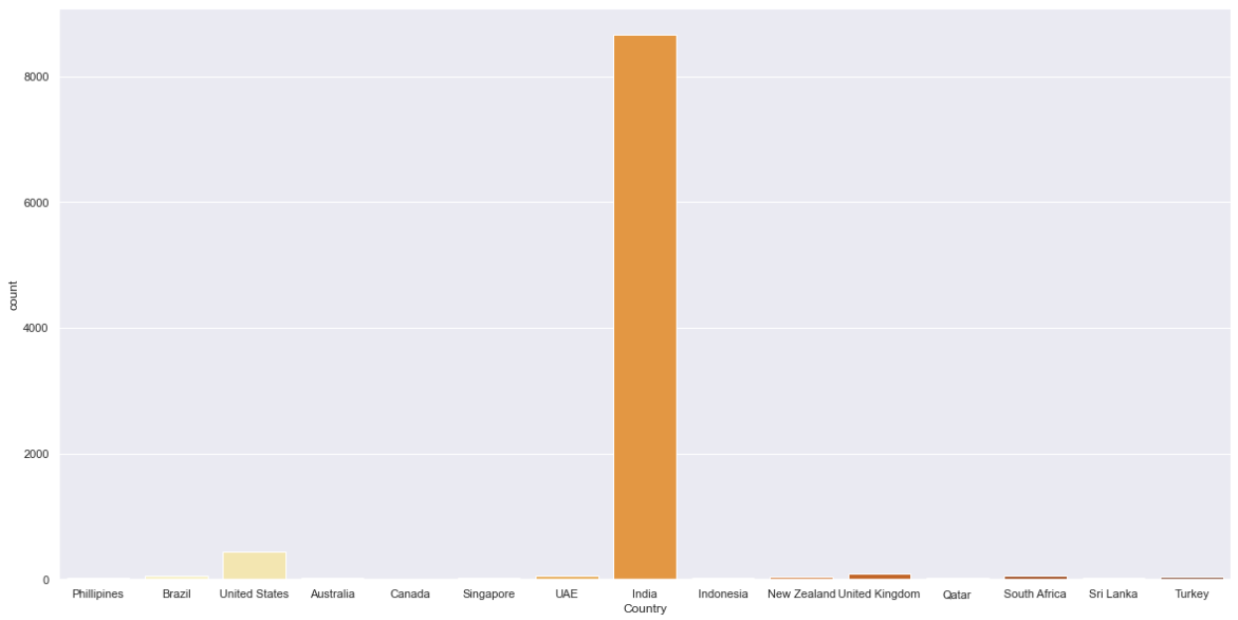
Data Visualization Analysis
- Indian restaurant listed maximum on zomato in the world.
© All rights reserved by Fireblaze Technologies Pvt. Ltd.

Slide 5
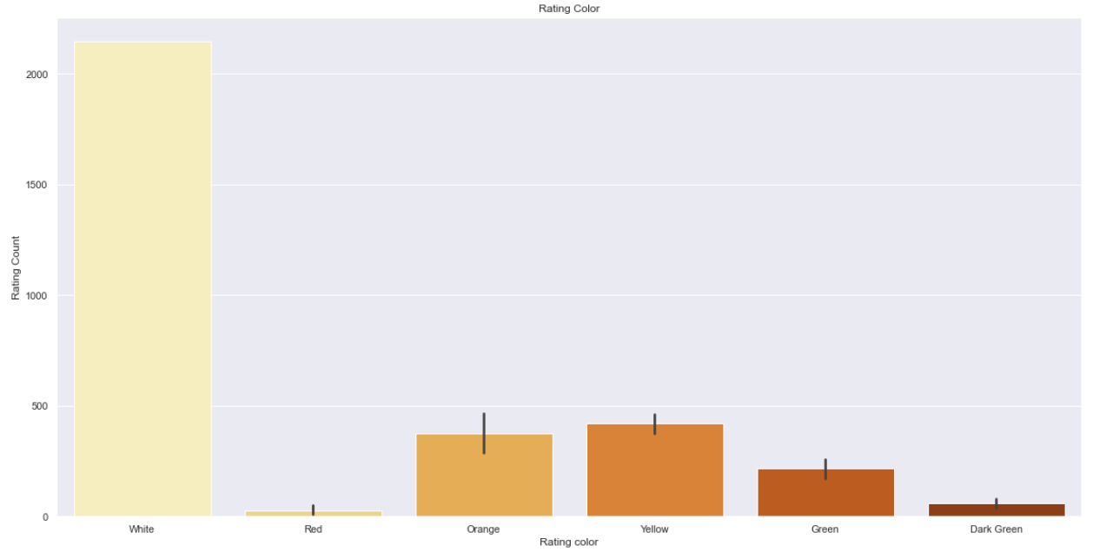
- Poor ratings got to maximum restaurant service from the users.

Slide 6
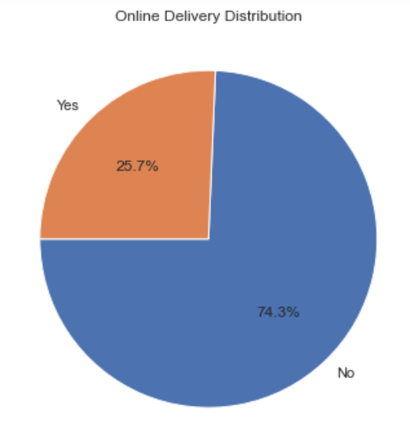
- Only 25% restaurants accepting the request for online delivery.

Slide 7
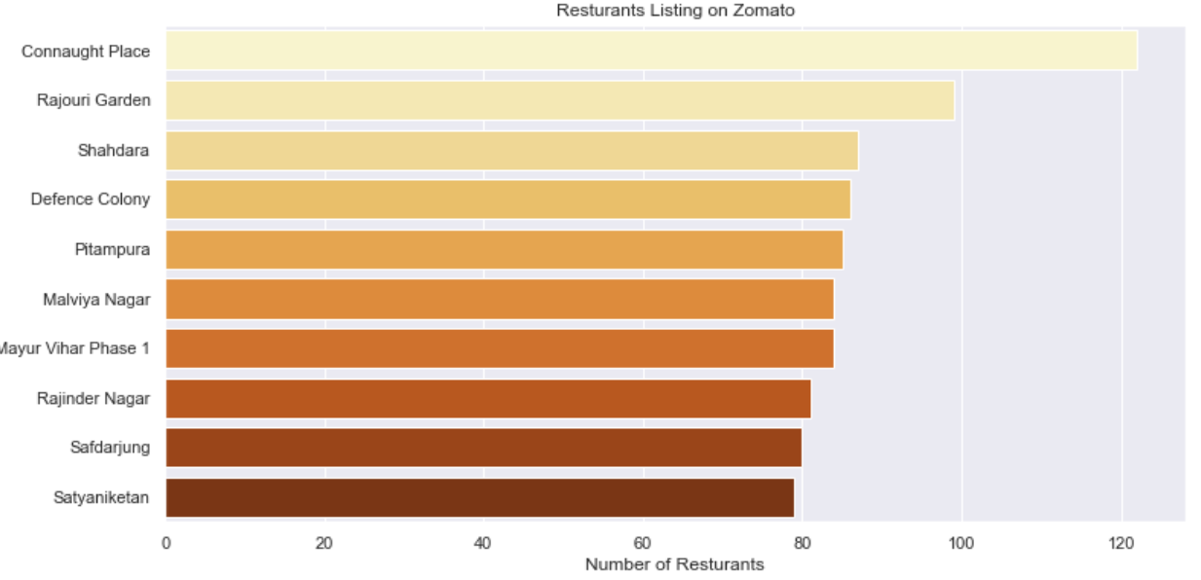
- Connaught Place have large no. of restaurant who listed on zomato in delhi

Slide 8
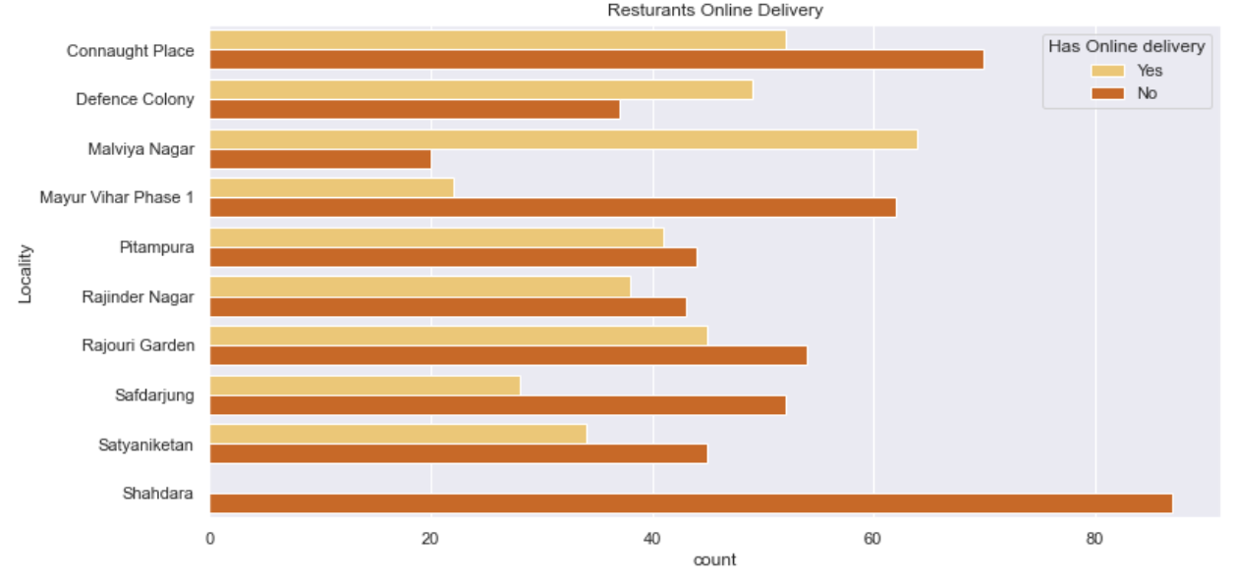
- Maximum places in delhi they are not accepting large no. of online delivery orders.

Slide 9
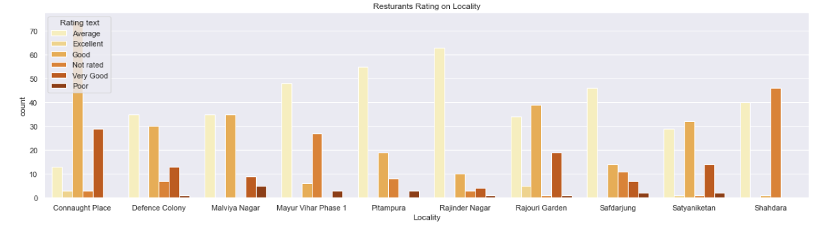
- More places got poor rating from users except connaught place in delhi.

Slide 10
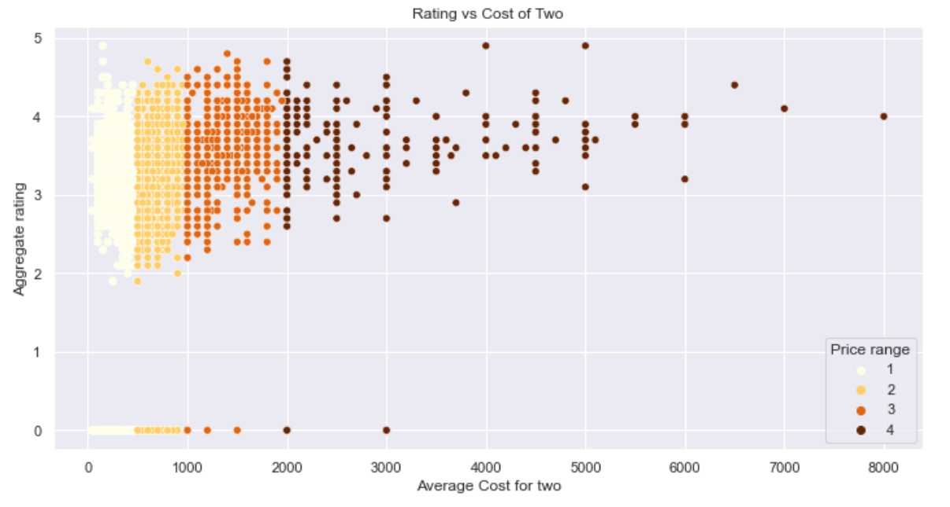
- All the restaurants have similar level of ratings.

Slide 11
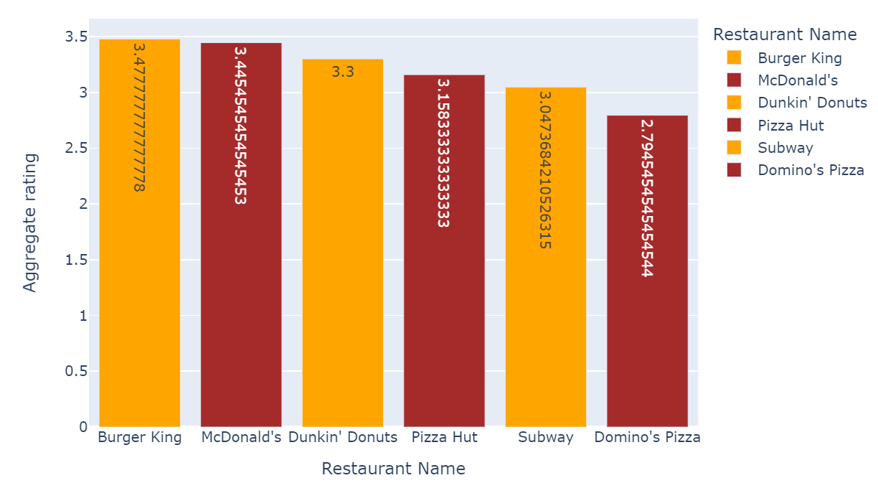
- Fast food restaurants (Burger king & McDonald’s) have more audience than others.

Slide 12
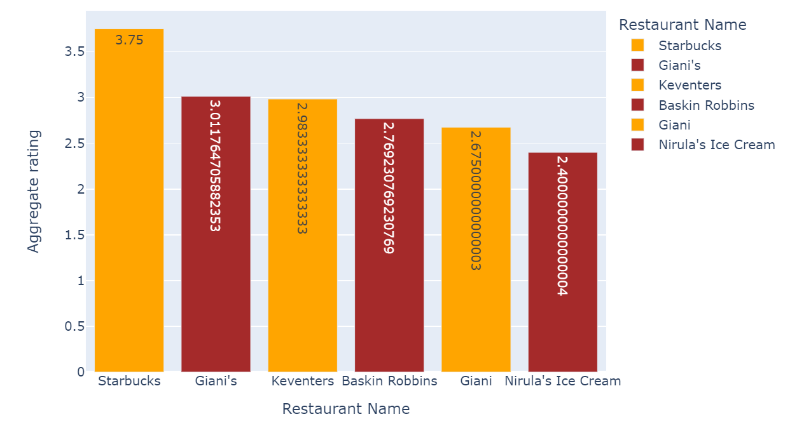
- Foreign brand (starbucks) have more audience than the local brands.

Slide 13
Advantage
We got information about how the online food delivery is working theses days.
We can upgrade features for capture more amount of audience.
© All rights reserved by Fireblaze Technologies Pvt. Ltd.

Slide 14
Conclusion
Connaught Palace has maximum restaurants listed on Zomato but in terms of online delivery acceptance Defence colony and Malviya Nagar seems to be doing better.
There is no relation between cost and rating. Some of the best-rated restaurants are low on cost.
© All rights reserved by Fireblaze Technologies Pvt. Ltd.

Slide 15
Future Scope
We should focus on audience requirements if the customer not like that service so customer will not use that service again in the future. & that user will advertise bad thing about the service/brand.
© All rights reserved by Fireblaze Technologies Pvt. Ltd.

